Slide 1



Slide 2



Welcome Parents
We are excited to welcome your child to Kindergarten!

Slide 3

Meet your Principal and Kindergarten Teachers
Principal – Mr. Robert Jones
Assistant Principal – Mrs. Diane Dunlap
Kindergarten Teachers – Mrs. Jo Banks, Mrs. Carey Clinton, Ms. Ashley Scilabro, Ms. Sheila Smith
Kindergarten Assistant - Ms. Sonia Asbrand
ESE Aide – Mrs. Kharene Ramos
ELL Resource Team – Mrs. Lorraine Fernandez, Mrs. Maribel Perotin
School Mission - Claywell Elementary will provide a collaborative, nurturing environment that empowers all individuals to be productive and responsible citizens.
School Vision - Claywell Elementary students will become respectful citizens and lifelong learners.

Slide 4
Steps to Enrollment
A parent/legal guardian must complete the registration process and provide the proper documents to the school site where the child will attend.
Your child can attend kindergarten next August as long as she or he turns 5 on or before September 1.
Your child is zoned for a particular elementary school based on your address. Find your assigned school.
For parents who wish to send their child to a school outside of their zoned area, see our choice options.
Registration will start in July.
Notes:
Early Childhood Programs and Kindergarten web page: https://hillsboroughschools.org/doc/2276/bold-beginnings/kindergarten/kindergartenreg/

Slide 5
Documents needed for enrollment
What forms do I need to compete?
  Student Enrollment Record Form - provided at school site ONLY
  Student Residency Form – can be completed ahead of time, supporting documentation is required

Slide 6
Documents needed for enrollment (Continued)
What supporting documents do I need to register for kindergarten?
  Birth certificate
  Social security card, if available
  Florida Physical HRS Form -- Florida Physical HRS form supplied by a doctor dated within 12 months prior to entry in Florida Schools (first day of school)
  Florida Immunization Record on HRS hard card (form #680) supplied by a doctor
  Two forms of verification of address that prove where you live but are NOT your driver’s license or state-issued ID card (some examples are a utility bill, lease, or a contract to purchase a home)
  If a child lives with someone who is not a parent, you may also need to complete a student resident form, which is available at the school
Notes:
Kindergarten Registration Checklist – English: https://hillsboroughschools.org/docs/00/00/22/76/K_Reg_Checklist.pdf
Kindergarten Registration Checklist – Spanish: https://hillsboroughschools.org/docs/00/00/22/76/K_Reg_ChecklistSP.pdf

Slide 7

Younger siblings and neighbors
Florida's Voluntary Prekindergarten Program (VPK)
  All of Florida's four-year-olds have access to free, quality prekindergarten programs. We have a wonderful VPK program onsite at Claywell Elementary
    4 years old on or before September 1
    https://www.sdhc.k12.fl.us/doc/list/early-childhood-programs-and-kindergarten/voluntary-prekindergarten/225-1241/
    Summer VPK
Notes:
Follow our Ready for Kindergarten monthly checklist to make sure your child is ready for Kindergarten!
https://hillsboroughschools.org/docs/00/00/24/24/CountdownKindergartenChecklist.pdf

Slide 8

Important Information
School Lunch Program
  Breakfast & Lunch are available for all students to purchase
  Free & Reduced Lunch Online Registration: https://www.sdhc.k12.fl.us/doc/list/student-nutrition-services/free-reduced-lunch-application/53-648/
  Menus: https://sdhc.nutrislice.com/
HOST Afterschool Care
  Online Registration: https://www.sdhc.k12.fl.us/doc/1418
  Arrival and Dismissal Procedures – Adults are placed around the school to help your child during arrival and dismissal.
  Any changes to dismissal should be in writing. Same day changes for should only be made in case of emergencies and have to be called into the office. The best way to help us keep your child safe during dismissal is to limit changes to dismissal as much as possible.
  We have several daycares that pickup from our site after school. Please register and arrange with the specific daycares for pickup
  Health Conditions – Please inform your teacher
  How to turn in paperwork and immunization information
Notes:
Lunch Program Application: https://www.sdhc.k12.fl.us/doc/list/student-nutrition-services/free-reduced-lunch-application/53-648/
HOST

Slide 9





School Uniforms
Uniforms are required.
  Red, white or navy polo shirt
  Solid khaki or navy bottoms (shorts, long pants, skirts or jumpers)
  Claywell-branded uniforms available through Kamenar Apparel
Provide school appropriate change of clothes in labeled ziplock bag to have available if needed.
  Please include undergarments and socks

Slide 10
Kindergarten Readiness
Academic Expectations of a Kindergarten Student
What is Kindergarten readiness?
VPK is available in summer at 15 HCPS schools!!!
Kindergarten provides an advanced academic program. Participation in VPK is a very important way to help your child be prepared for entering Kindergarten.
Notes:
Follow our Ready for Kindergarten monthly checklist to make sure your child is ready for Kindergarten!
https://hillsboroughschools.org/docs/00/00/24/24/CountdownKindergartenChecklist.pdf

Slide 11
Steps to be ready!
Physical
  Use pencils pens and markers (practicing proper grip)
  Cuts with scissors
  Throws a ball, skips and hops
Emotional
  Demonstrates self-control, avoids melt-downs, able to wait for a turn, comfortable with new environments and new people
  Visits a variety of places like libraries, museums, future school
Social
  Plays well with others, shares, resolves conflicts with words
  Uses proper safety measures, is provided opportunities to play with other children: sports, park, etc…

Slide 12
Steps to be ready!
Cafeteria Skills
  Can independently open milk, packages, juice boxes, etc…
  Stay seated the entire duration of lunch – 30 minutes
  Uses good manners – keeps area clean, doesn’t play with food
  Doesn’t share food (food allergies)
Independent Personal Care
  Can use restroom (includes wiping independently)
  Can wash hands
  Can blow nose
  Can independently tie shoes (or use Velcro)
  Can zips, snap and button own clothes

Slide 13
Important Tips
  Focus on lower-case letters when practicing sounds
  PLEASE CHOOSE VELCRO SHOES (note: Most kids can learn to tie shoes around 5 years old but the dexterity to do it stays tied all day takes a bit longer to develop.)
  Avoid light-up shoes, sequins, and other distracting clothing or jewelry
  NO CROCS - unsafe at school
  Build fine motor skills with activities like playdoh, fingerpainting, stringing beads, and crafts involving tearing paper, cutting, and pasting

Slide 14

Academic steps to be ready!
General
  Can sit and listen attentively for several minutes at a time
  Has ability to focus on tasks independently
Ready to Read
  Has knowledge of letters & letter sounds
  Listens attentively to all kinds of books being read to him/her every day
  Asks and answers questions about text
Ready to Write
  Holds pencil and crayons with the proper grip
  Writes name (using only one capital at the beginning of the name)
Ready for Math
  Has knowledge of numbers and counting
  Has knowledge of shapes and patterns

Slide 15
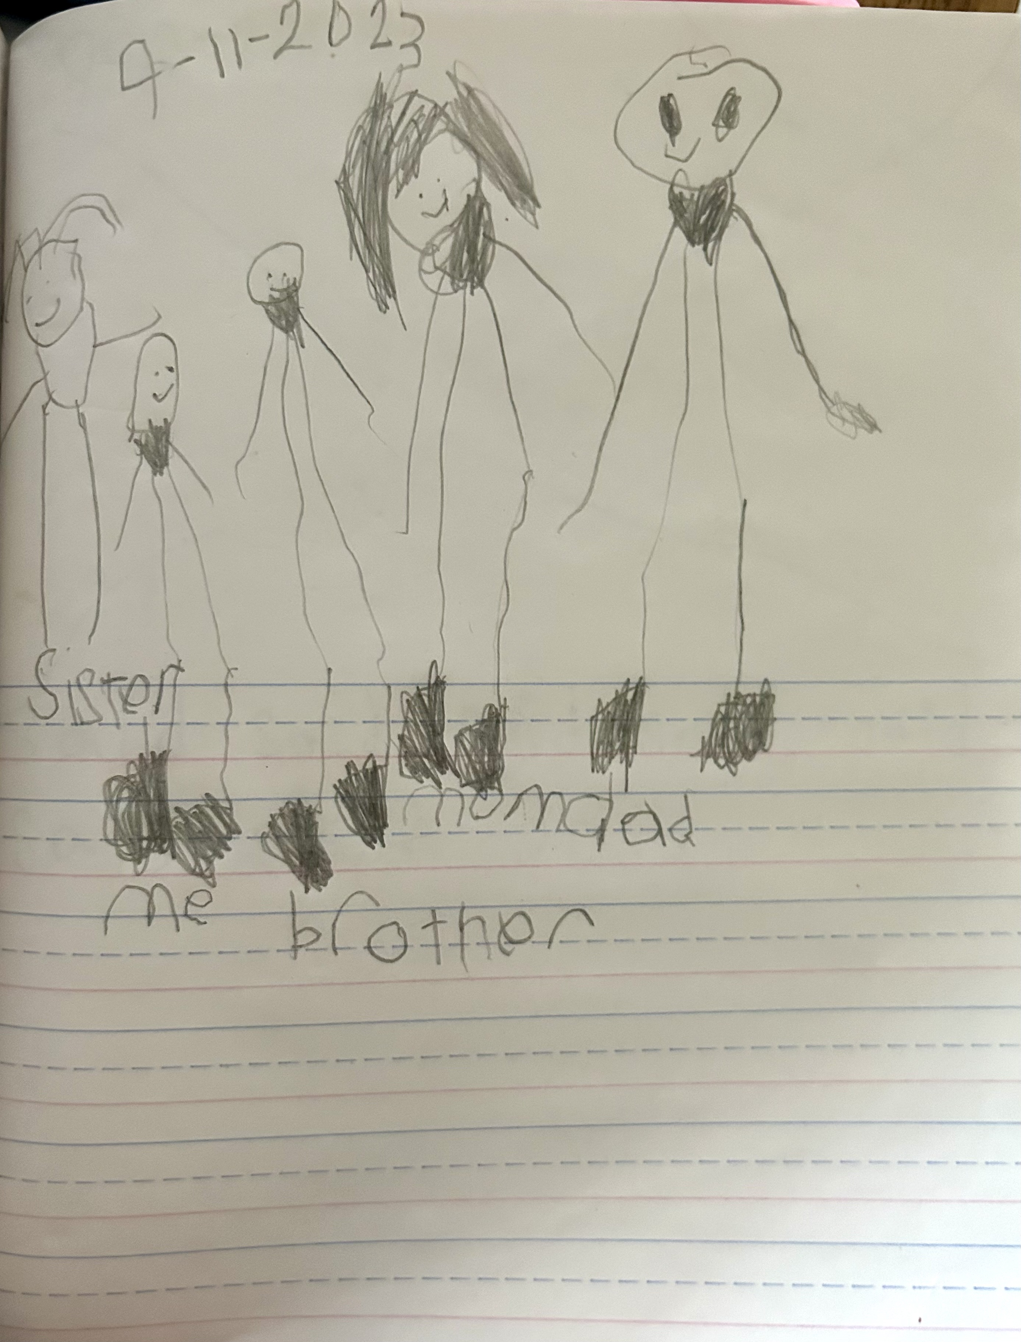
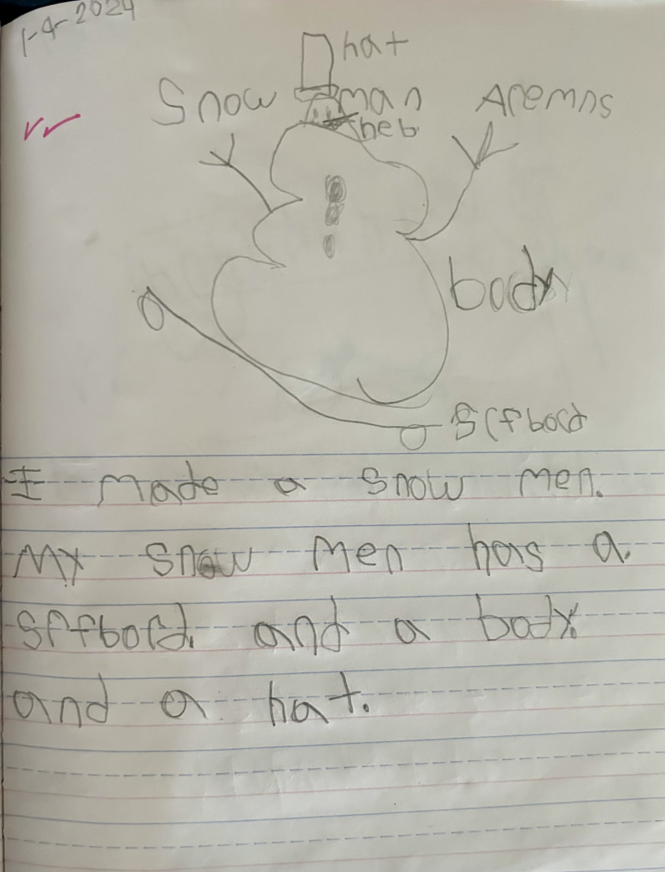
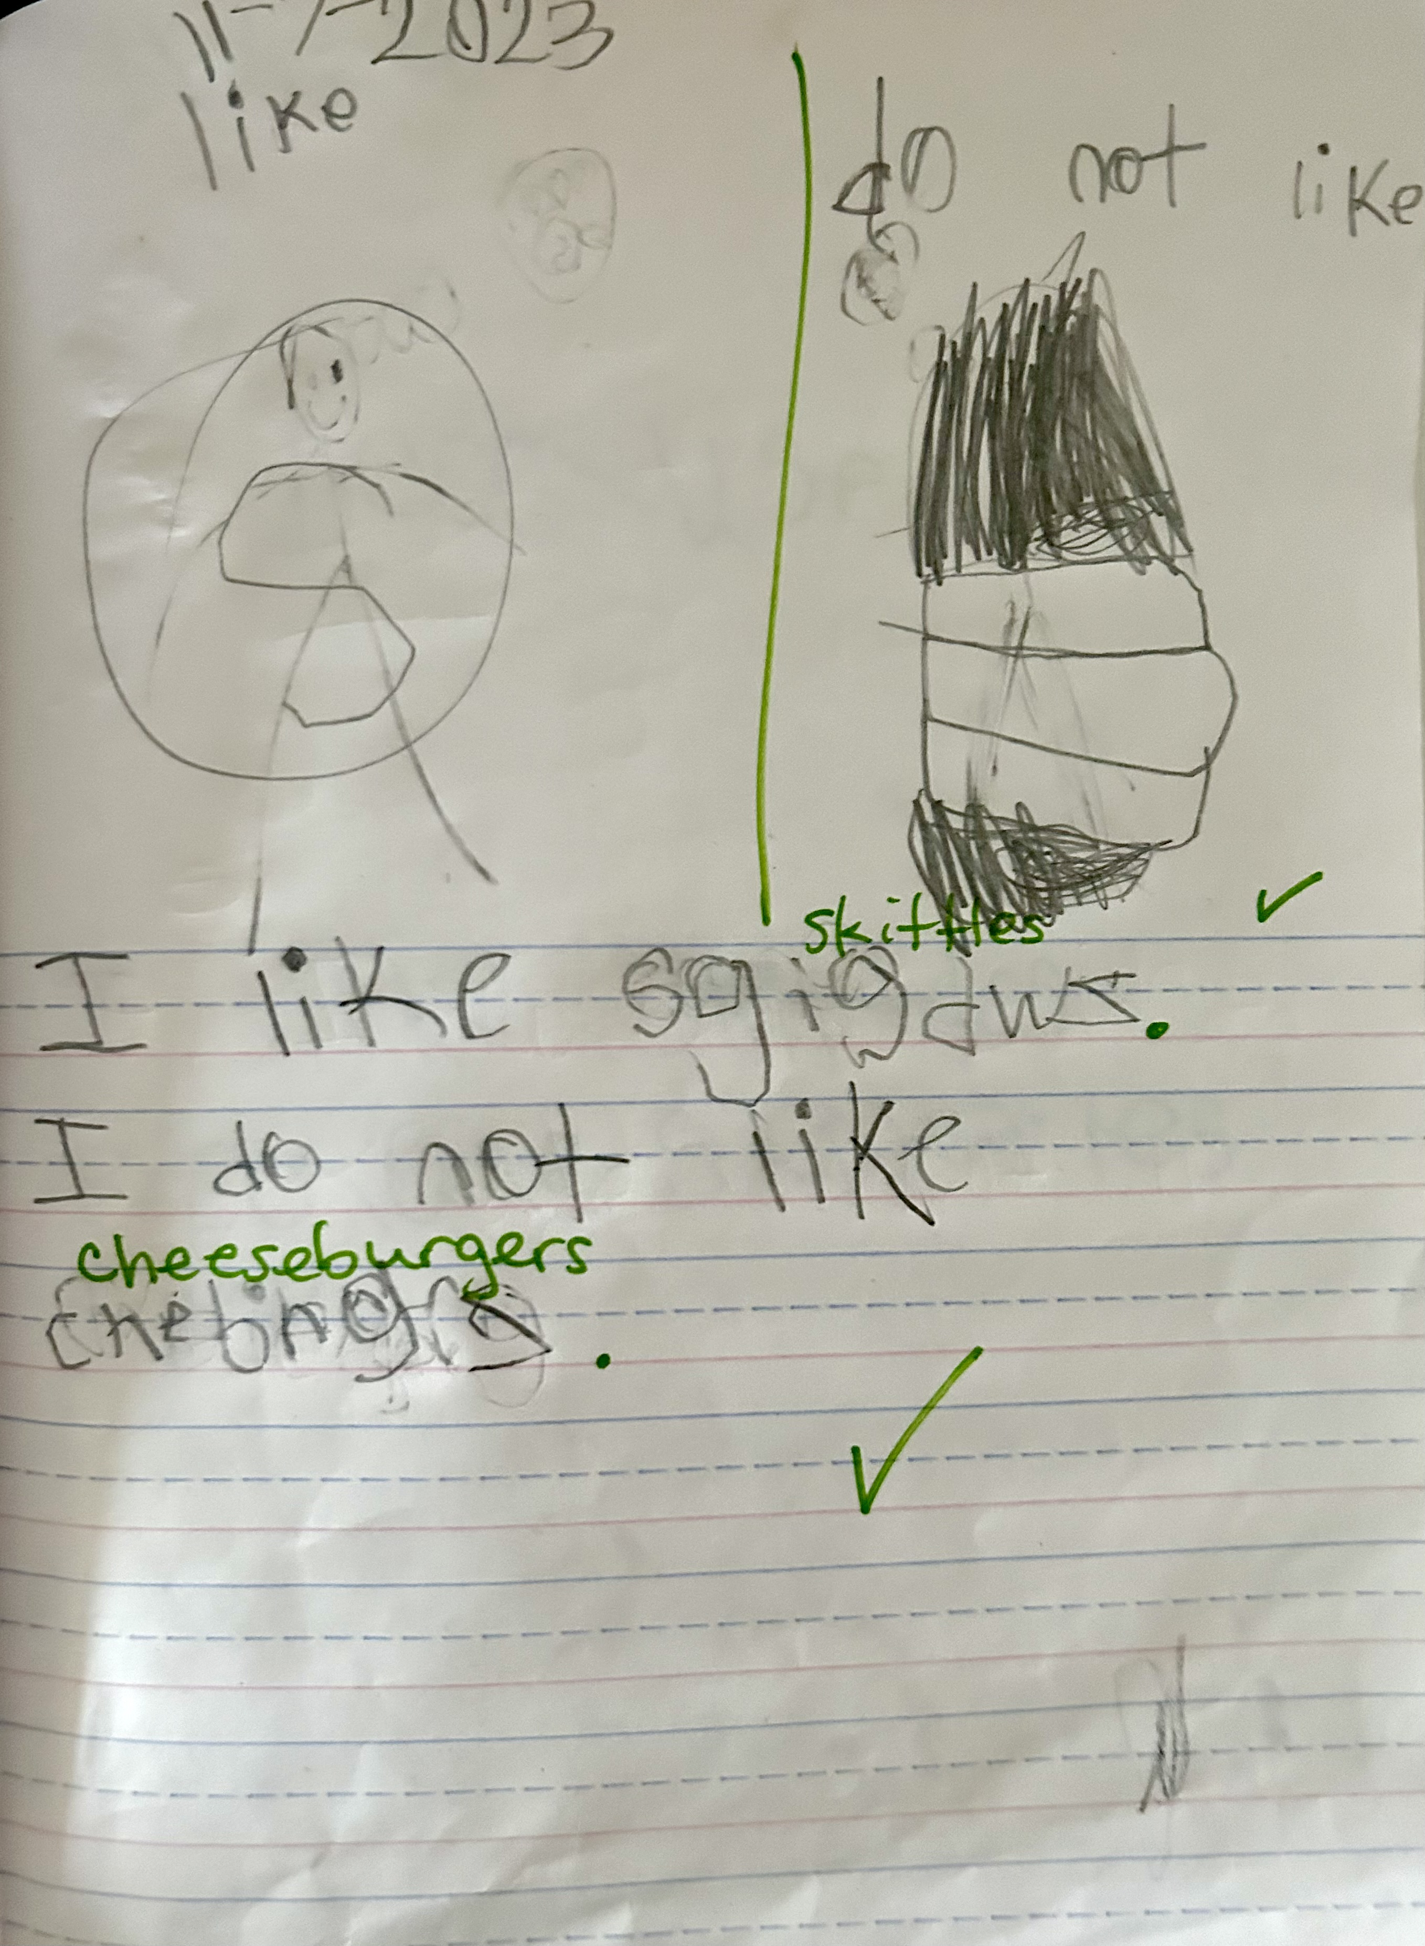
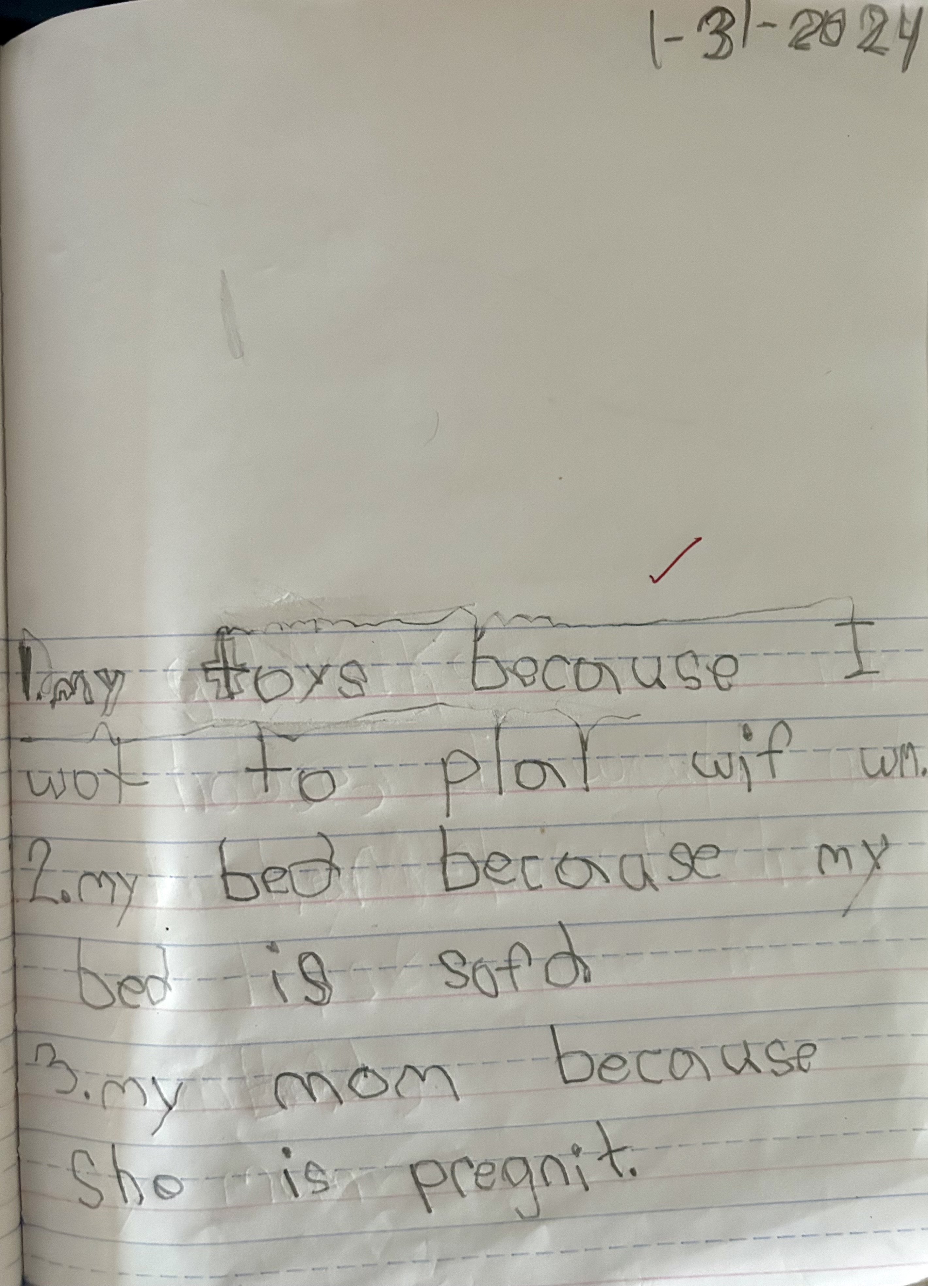
Sample Writing Progression
November
February
September
January

Slide 16
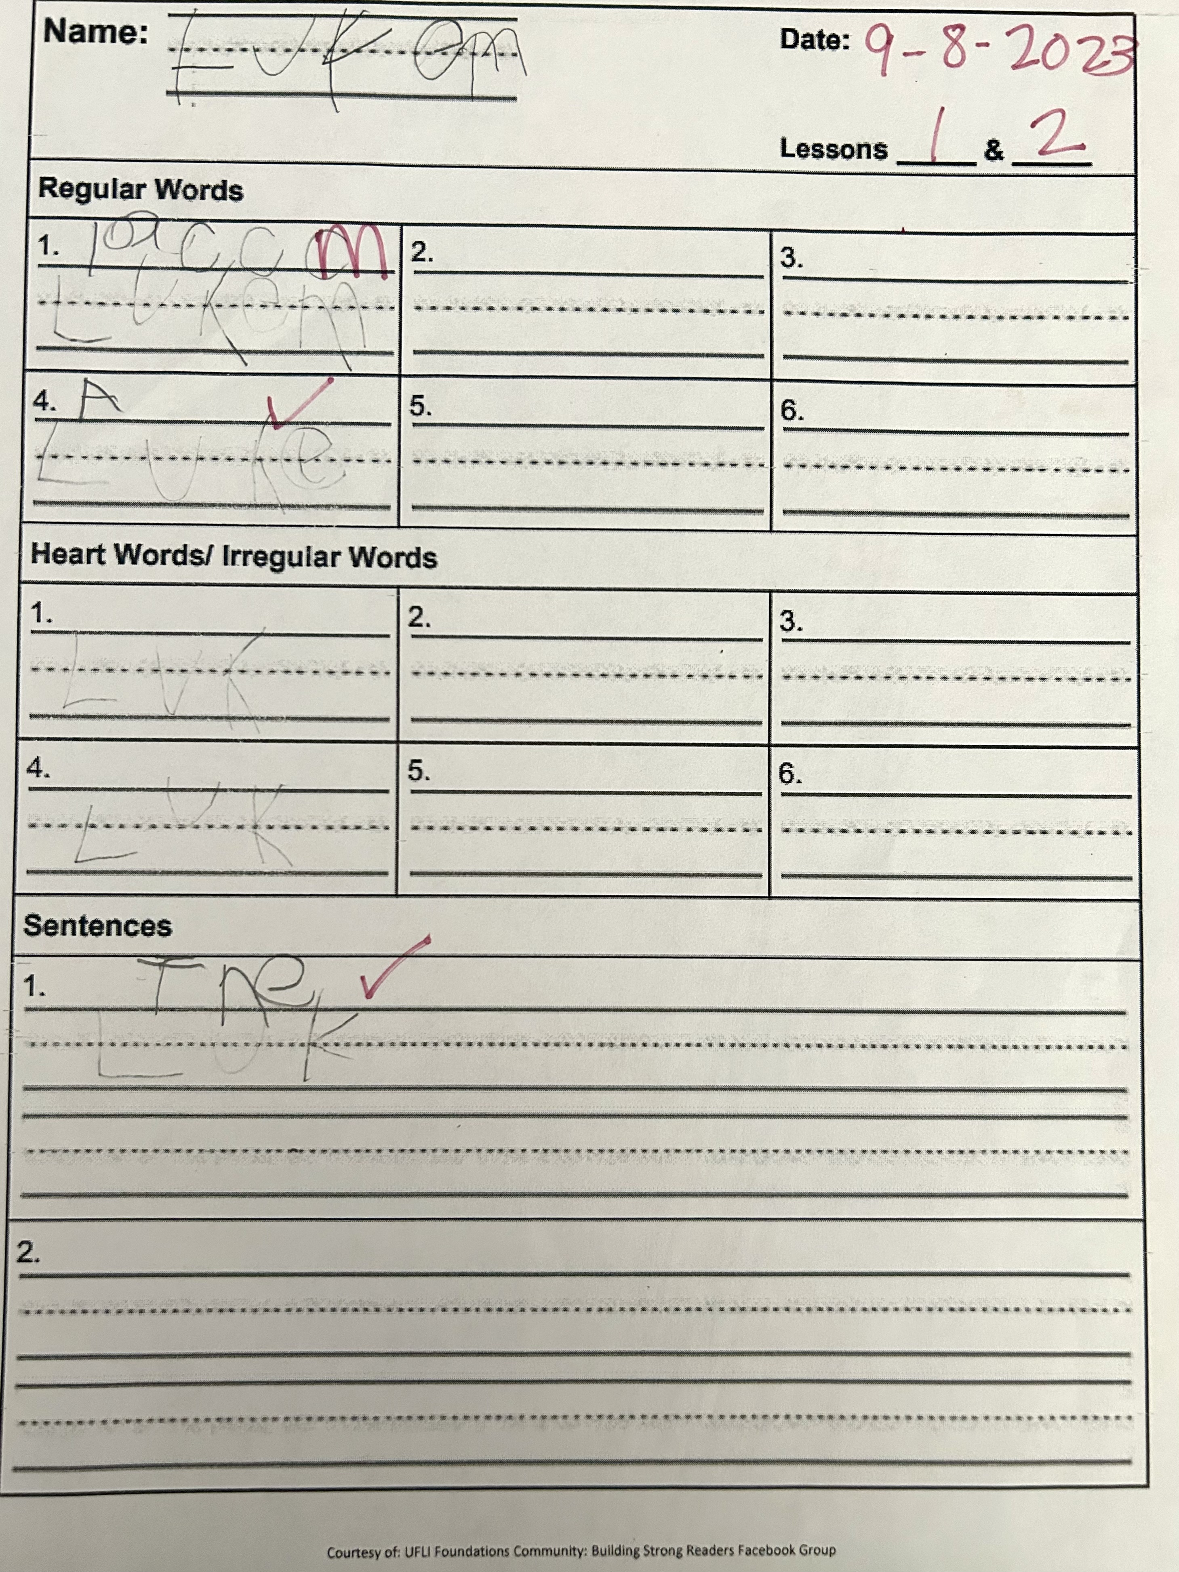
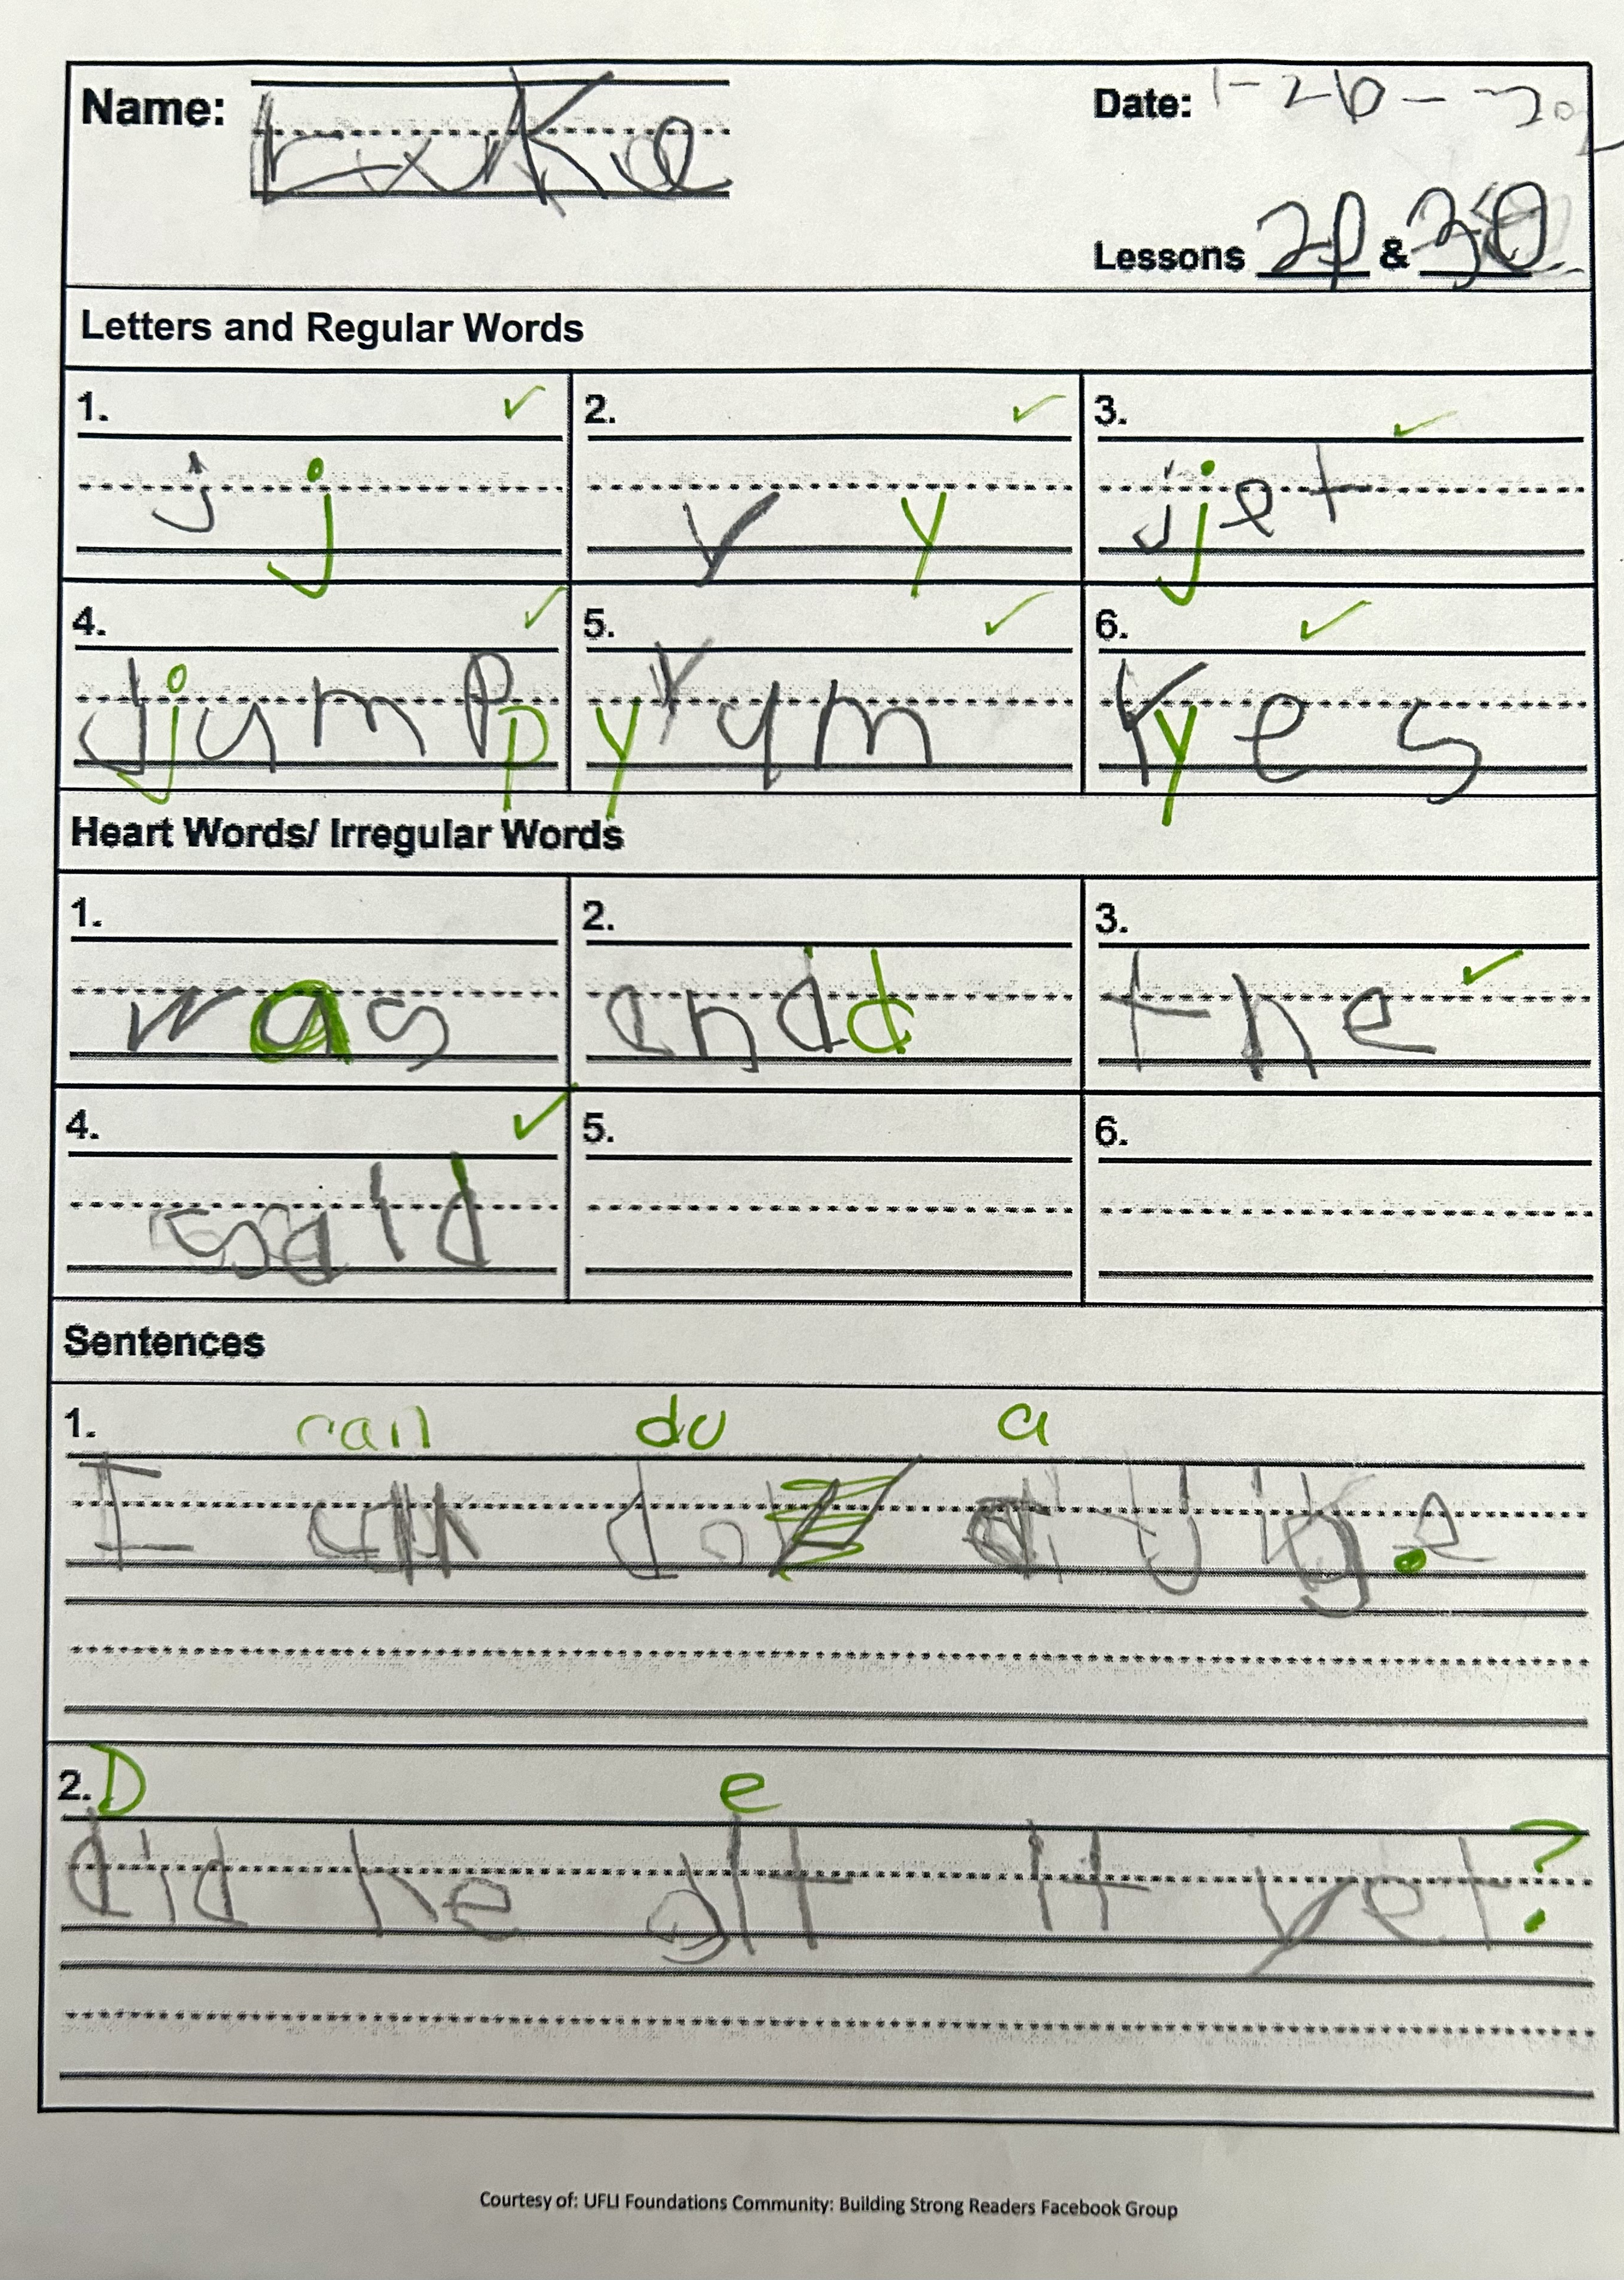
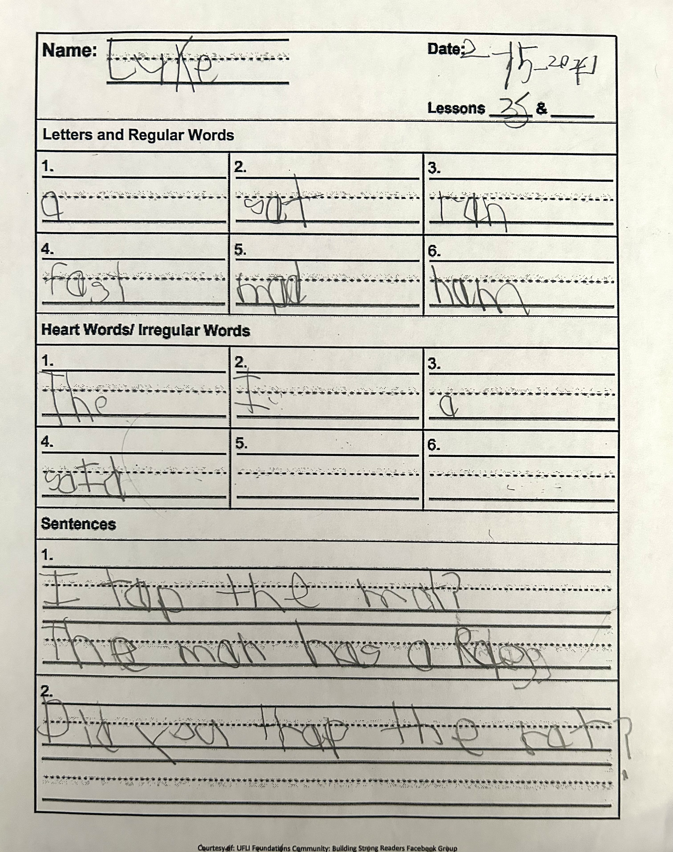
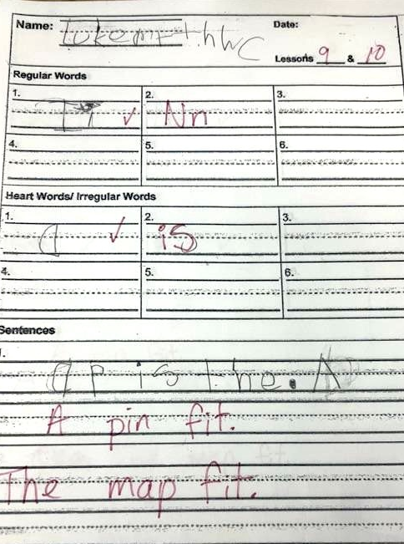
Sample UFLI (Phonics Program) Homework & Assessments
October
February
September
January

Slide 17
Daily Routines
Morning Procedures (Breakfast)
Reading (Read-aloud, Phonics, Rotations)
Writing (We do, I do, You do)
Math (Manipulatives, rotations)
Science (long term investigations, STEM, hands on)
Social Studies/Skills
Lunch
Outside Time
Afternoon Procedures (Dismissal)

Slide 18
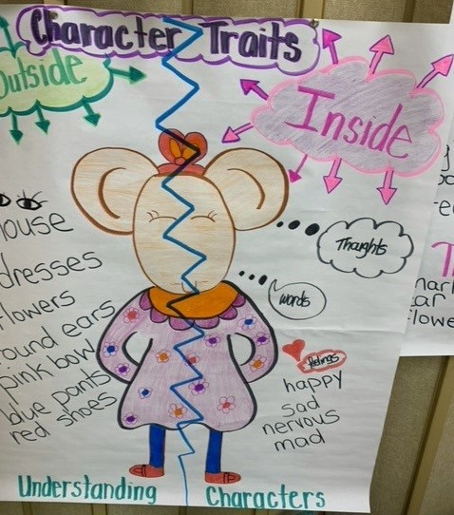
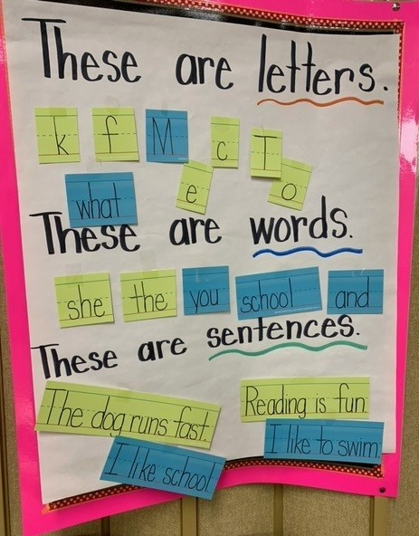
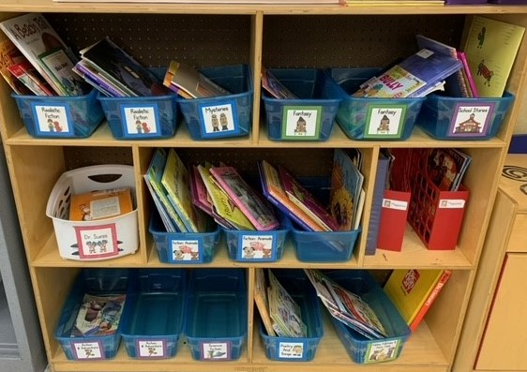
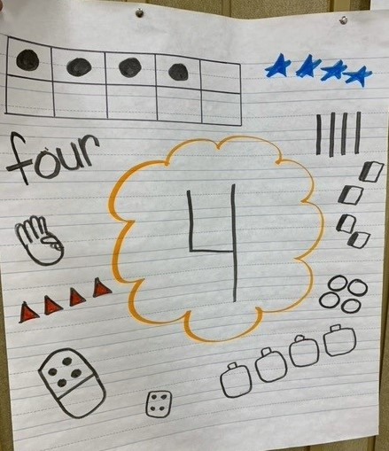
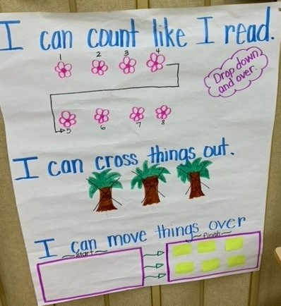
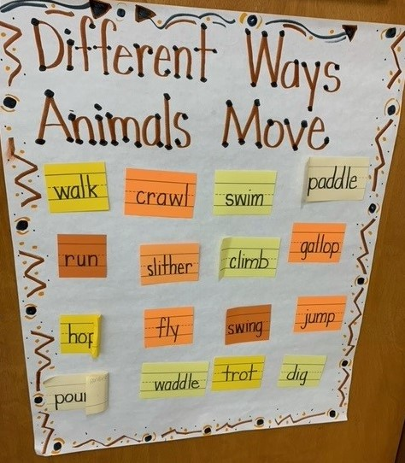
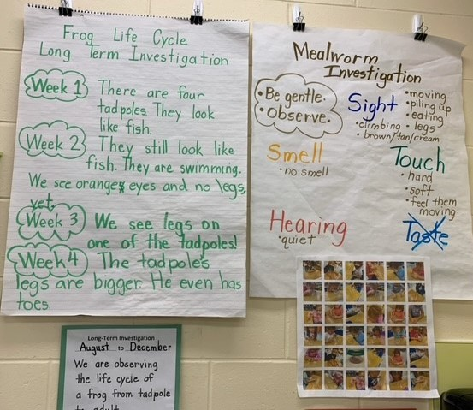
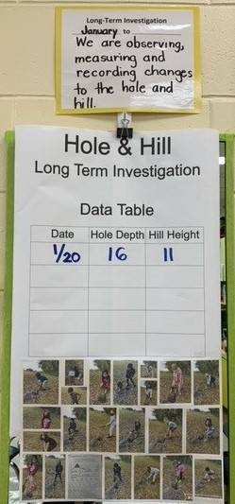
Around the Classroom

Slide 19
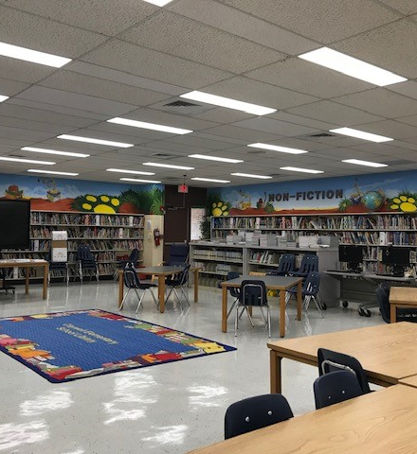
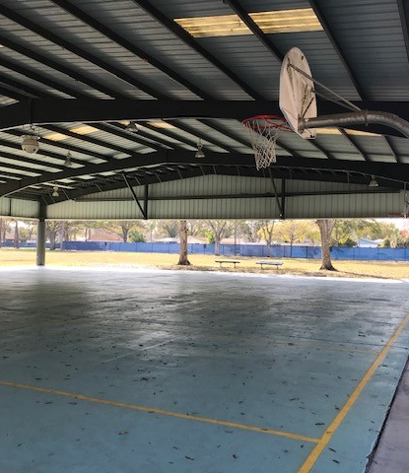
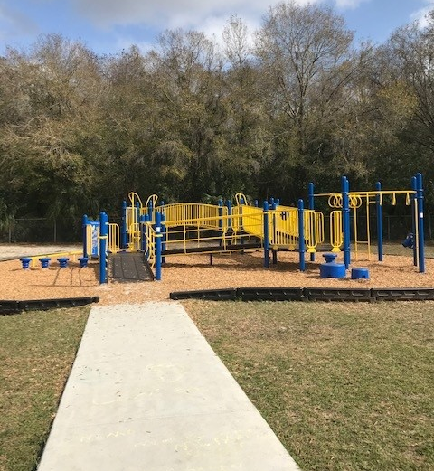
Around the School

Slide 20

Resources
VROOM.org
  Vroom is a global program of the Bezos Family Foundation. FREE, science-based tips and tools help parents and caregivers give children a great start in life today—and an even better future.
PBSkids.org
  PBS KIDS is here to help no matter what learning situation your family is facing this year. Every week, we’ll provide a new at-home learning topic with activities, games, and articles — featuring your favorite PBS KIDS characters like Daniel Tiger, Elmo, and the Kratt brothers — to keep your child learning through play.
JumpStart.com
  Readily available educational resources for parents, teachers and students make the process of learning and teaching a lot easier and more fun for everyone.

Slide 21
Free Online Resources Con’t
YouTube
Jack Hartmann – subscribe to his channel
Alphablocks
Numberblocks
Have Fun Teaching
Gracie's Corner
ABCya! abcya.com
Starfall.com Preschool & Kindergarten
UFLI

Slide 22


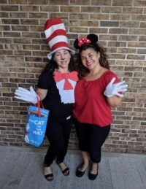
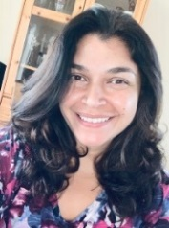
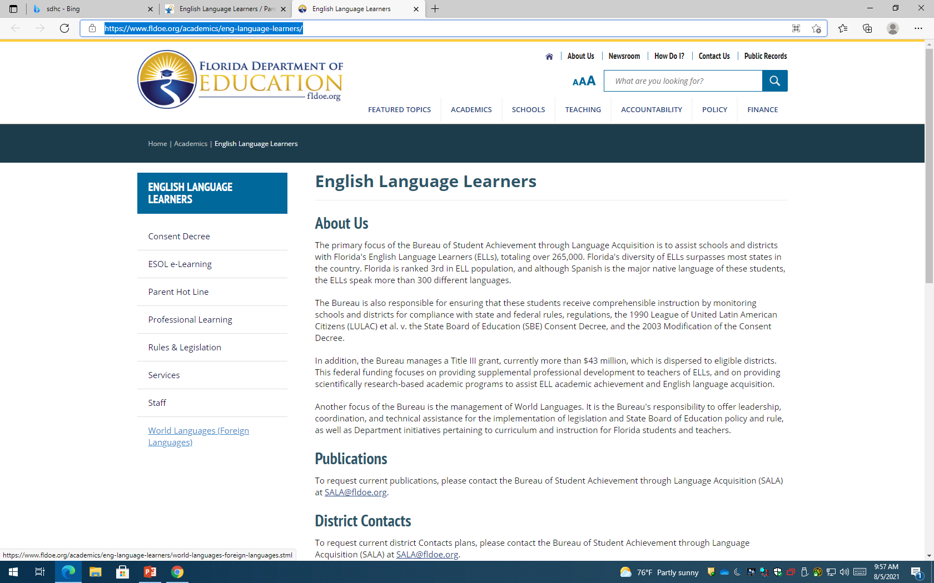
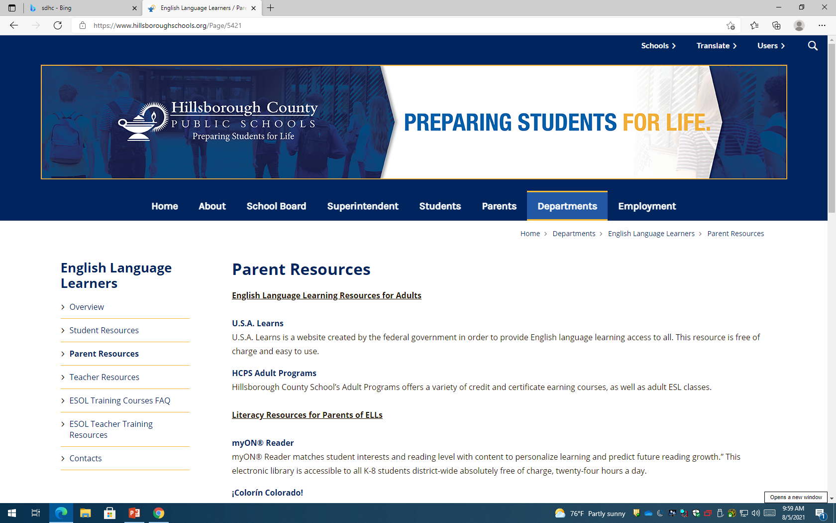
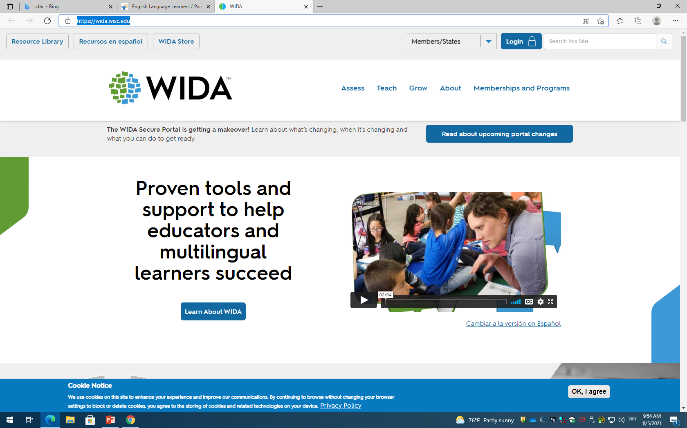
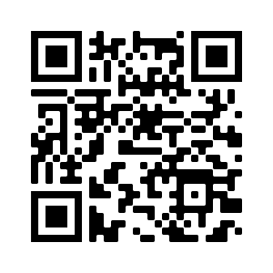
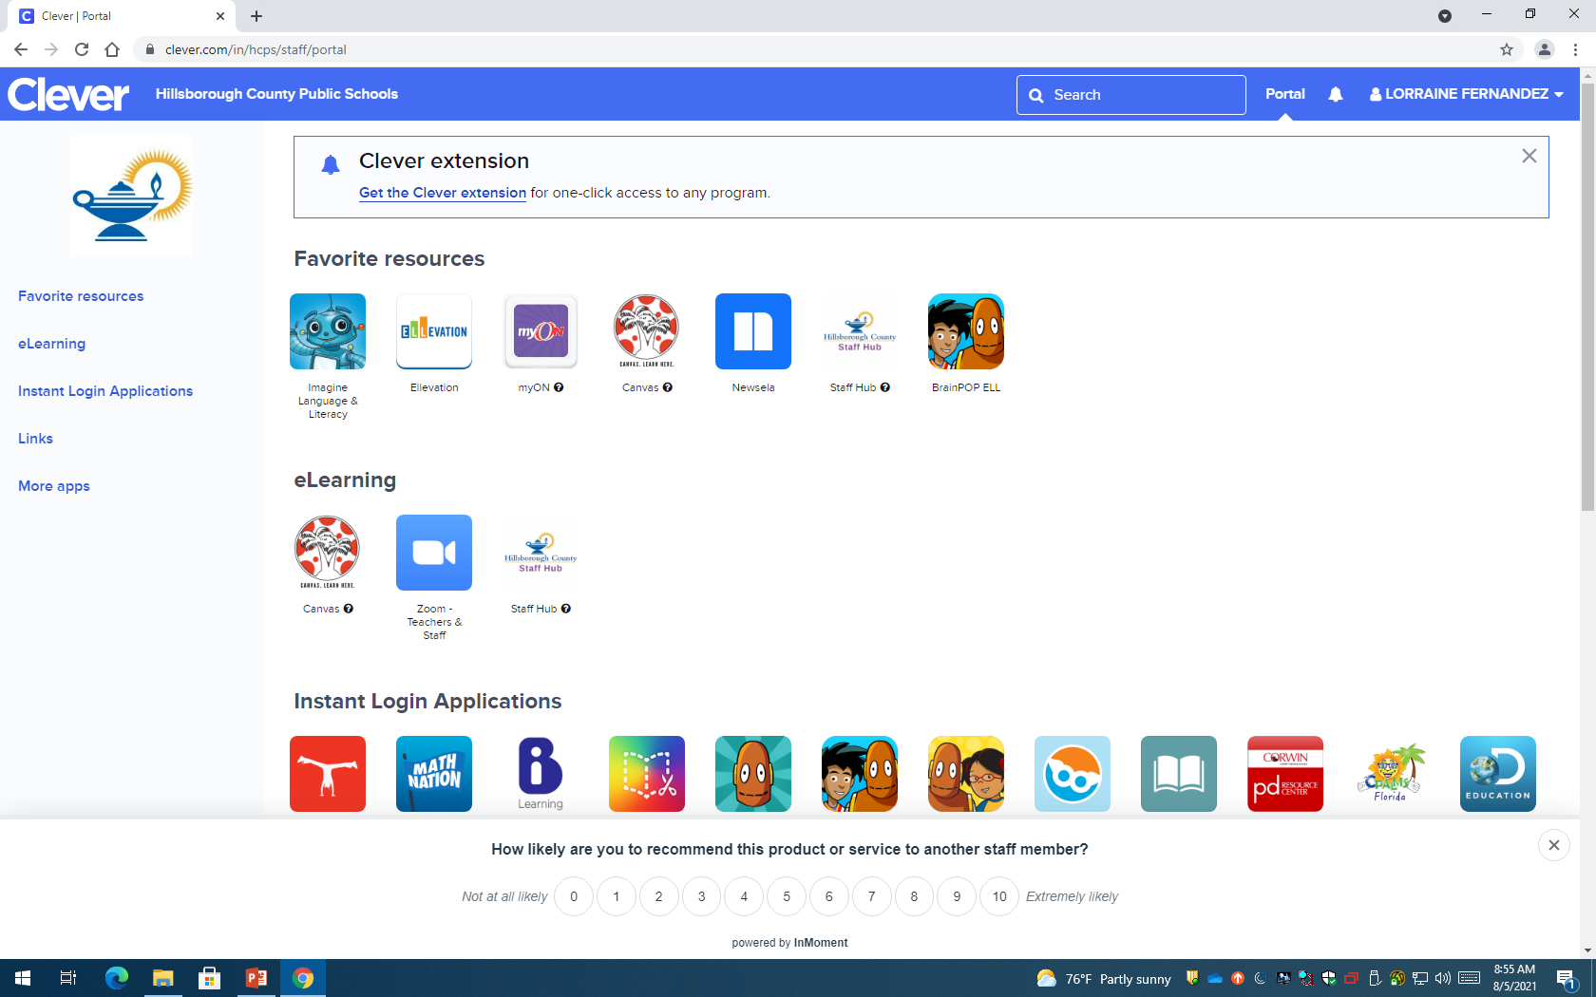

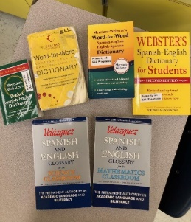
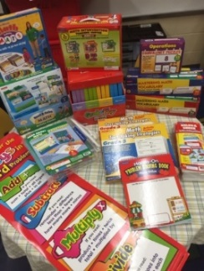
Program for English Language Learners (E.L.L.)
Claywell Elementary 813-975-7300 (Mrs. Maida Lopez is bilingual) http://claywell.mysdhc.org
Meet the E.L.L. Dept. staff:
* E.L.L. Resource Teacher: Mrs. Lorraine Fernandez lorraine.fernandez@hcps.net
* Spanish Bilingual Paraprofessional: Mrs. Maribel Perotin maribel.perotin@hcps.net
The E.L.L. program is a state-wide, federally funded program that was put into place in 1990. Claywell’s E.L.L. staff identifies students in need of accommodations, support & resources to acquire the English language in order to attain academic success. *Classroom E.L.L. teachers provide E.L.L. students comprehensible academic instruction through the use of eligible accommodations, modifications, differentiation, and district & school programmatic resource materials. The E.L.L. staff handles compliance, provides additional support, materials & resources to teachers & students.
English Language Learners (fldoe.org)
English Language Learners / Overview (hillsboroughschools.org)
WIDA (wisc.edu)
E.L.L. programmatic student resources:
Scan the QR code to add your contact info. to our E.L.L. ClassDoJo
Escanea el código QR para agregar tu información de contacto. a nuestro E.L.L. ClassDoJo

Slide 23




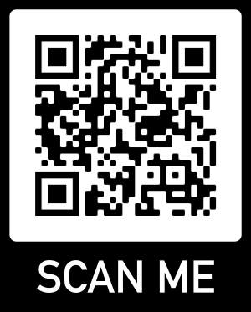
JOIN PTA - PTA membership and dues support your child through:
EDUCATION
PTA support students, teachers and curriculum needs.
ADVOCACY
PTA advocates on behalf of children at your school at the local, state and national levels.
COMMUNITY
PTA a welcoming, inclusive community, committed to strengthening the connection of all families.
PROSPECTIVE PTA MEMBERS
Join online using MemberHub - scan the QR Code or visit the link below
https://claywelles.new.memberhub.store/store
Notes:
Script:
The supporting themes and corresponding messages elaborate on the overarching message and highlight the three areas that define PTA and what it supports: education, advocacy and community
Focusing PTA’s supporting themes and messages around three key areas is critical to reshaping the current perceptions of PTA
For education, we need to think about: how does PTA support students, teachers and curriculum needs?
With advocacy, we need to consider: how does PTA advocate on behalf of children at your school at the local, state and national levels?
And, for community how is PTA a welcoming, inclusive community, committed to strengthening the connection of all families?
Along with each supporting theme and message, we have developed proof points that are the supporting facts for each theme and literally serve as the “proof”
Now we’re going to review each supporting theme in-depth
And, as we go through each supporting theme and corresponding proof points, I want you to begin to think about how you can tailor the proof points to your local PTA

Slide 24
Important Contact Information & Hours
School Phone Number: (813)975-7300
School Website: https://www.hillsboroughschools.org/claywell
School Student Hours:
Monday – 7:40 a.m. – 12:55p.m.
Tuesday – Thursday 7:40 a.m – 1:55 p.m.

Slide 25

Questions and Answers
Please use this time for any questions you may have. During the tour we will not have time to answer questions as we will need to move quickly so the school can be locked down.
Thank you!
Notes:
The READY FREDDY ™ logo and trademark is owned by the University of Pittsburgh Office of Child Development, and is being used under license. ReadyFreddy.org

Slide 26
School Tour
This concludes our presentation.
Please collect all your belongings.
We will quickly walk-through 2 Kindergarten classrooms, the Kindergarten kitchen, the atrium, cafeteria and end at the car line.
Thank you for attending this year's Getting Ready for Kindergarten Presentation.

